Slide 1

Introduction to Phishing
Phishing is a type of cybercrime that uses fraud emails, websites, or text messages to trick people into revealing their personal information, such as usernames, passwords, or credit card details.

Slide 2
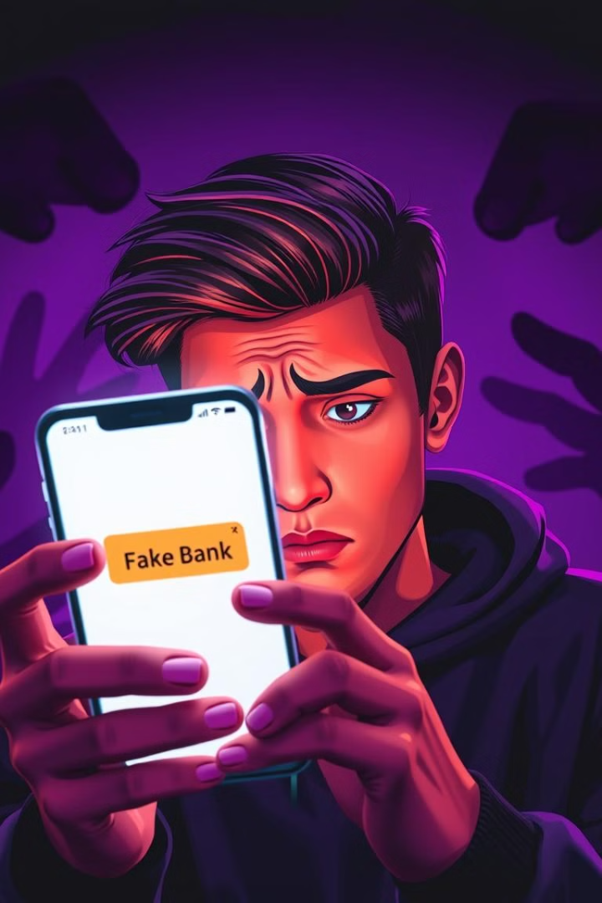
Types of Phishing Attacks
1
Spear Phishing
2
Whaling
Spear phishing is a targeted phishing attack that is specifically designed to target a particular individual or organization. It typically involves using personalized information to make the attack more convincing.
Whaling is a type of phishing attack that targets high-level executives or other high-profile individuals. It often involves sophisticated techniques to gain access to sensitive information or financial resources.
3
Clone Phishing
4
Deceptive Phishing
Clone phishing is a type of phishing attack that involves sending out emails that appear to be legitimate communications from a known source. The attacker may modify the email's content slightly to try and trick the recipient into clicking on a malicious link or opening a malicious attachment.
Deceptive phishing involves creating fake websites or emails that look like legitimate websites or emails from well-known companies.

Slide 3

Phishing Techniques
1
Email Spoofing
Spoofing involves making an email appear to be from a trusted source when it's actually from a scammer.
2
URL Manipulation
Attackers often create URLs that look almost identical to legitimate URLs but redirect to a malicious website.
3
Social Engineering
Phishing attacks frequently use social engineering tactics to convince victims to divulge their personal information.
4
Malicious Attachments
Phishing emails might include malicious attachments, which can be used to install malware on victims' computers.

Slide 4
Social Engineering in Phishing
Pretexting
Baiting
Phishing
Attackers invent a scenario to convince victims to provide personal information.
Baiting involves tempting victims with something appealing, like free software or a prize, to lure them into a phishing trap.
Phishing attacks use deceptive emails, websites, or text messages to trick people into revealing their personal information.

Slide 5





Identifying Phishing Attempts
Verify the Sender's Address
Check the sender's email address to make sure it matches the organization's official website.
Look for Suspicious Links
Hover over any links in the email before clicking to see the actual URL and verify that it's legitimate.
Check for Spelling and Grammar Errors
Phishing emails often have typos and grammatical errors.
Be Aware and Doubtful of Urgent Requests
Phishing emails often try to create a sense of urgency, so be cautious about any requests for immediate action.

Slide 6

Protecting Yourself from Phishing
Be Aware
Use Strong Passwords
Be cautious when opening emails, clicking on links, or downloading attachments. Be aware of the common tactics used in phishing attacks.
Create strong, unique passwords and don't reuse the same password across multiple accounts.
Enable Two-Factor Authentication
Keep Your Software Up to Date
This adds an extra layer of security to your accounts by requiring a code from your phone or email in addition to your password.
Regularly update your operating system and software to patch security vulnerabilities.

Slide 7
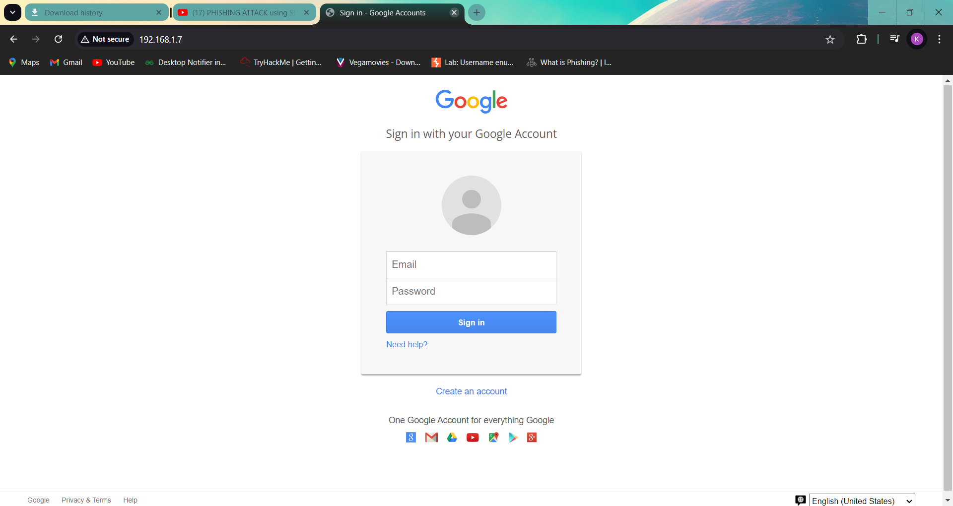
This is the example of Phishing in this we made a fake
Web page of Google so that we can spoof the
Credentials of the target

Slide 8
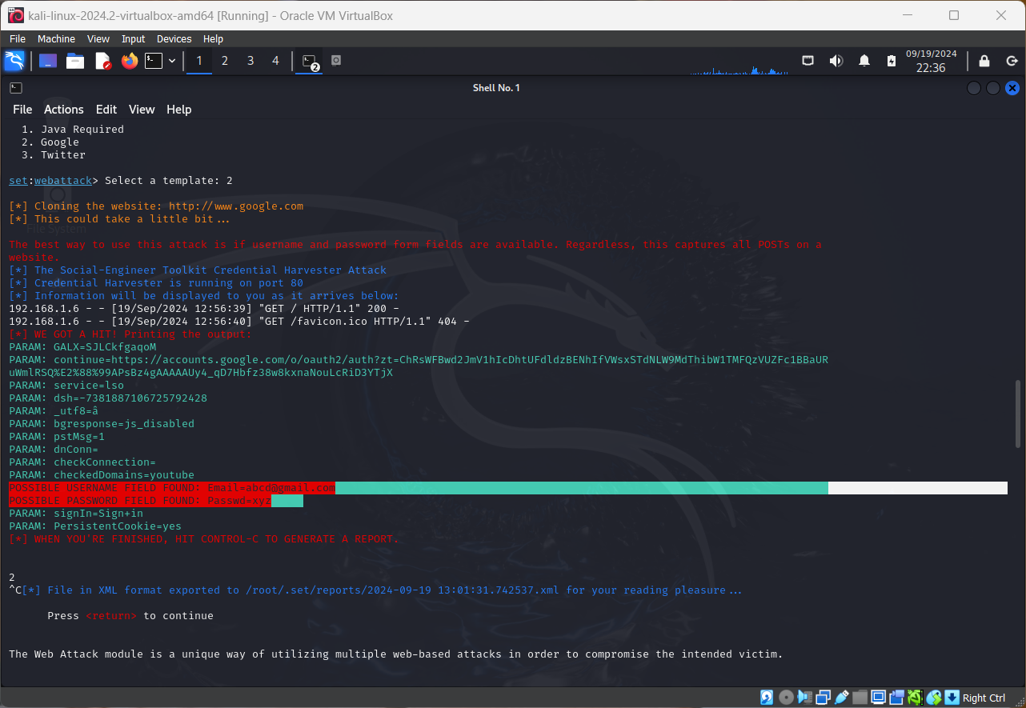
You can see we got the
username and password of the victim

Slide 9
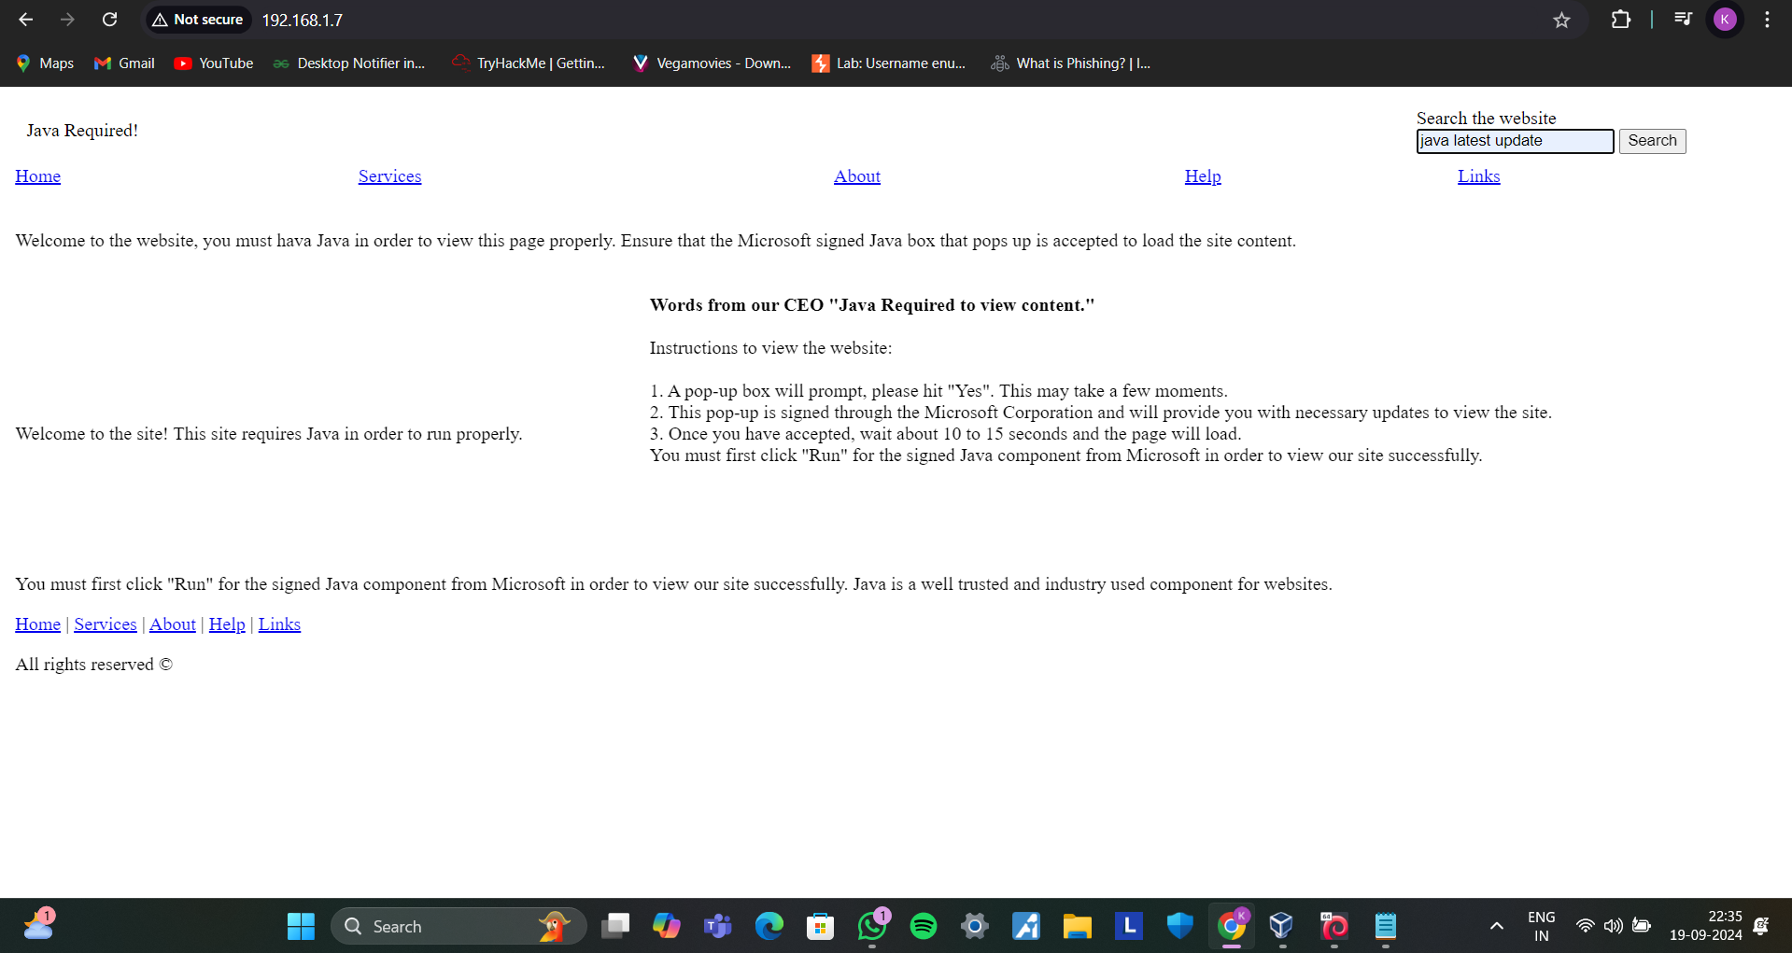

Slide 10
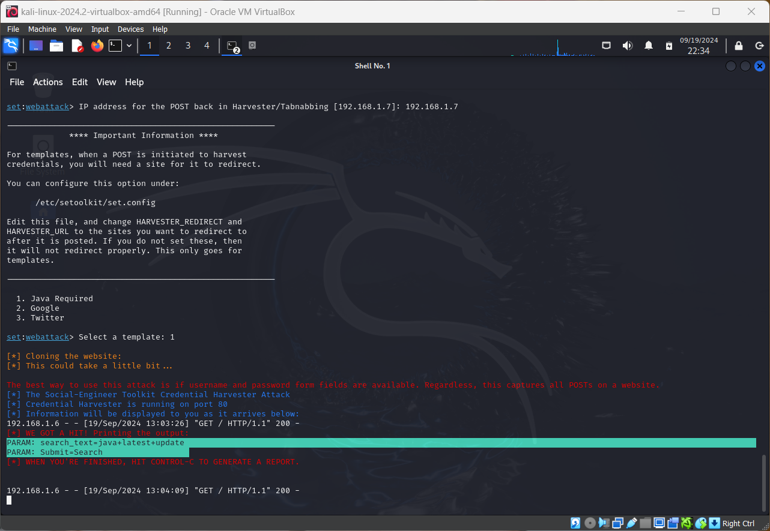

Slide 11

THANK YOU

